Slide 1
Sean Koppenhafer, Jaime Rodriguez,
Chad Thueson, Noah Erickson, Rishal Dass
Project Proposal
Digital Dash
Portland State University
Department of Electrical and Computer Engineering (ECE)

Slide 2
Overview
Devices Choosen
  Microcontroller
  CAN Transceiver
  LCD Screen
GUI Layout
Enclosure
Budget
Project Timeline

Slide 3
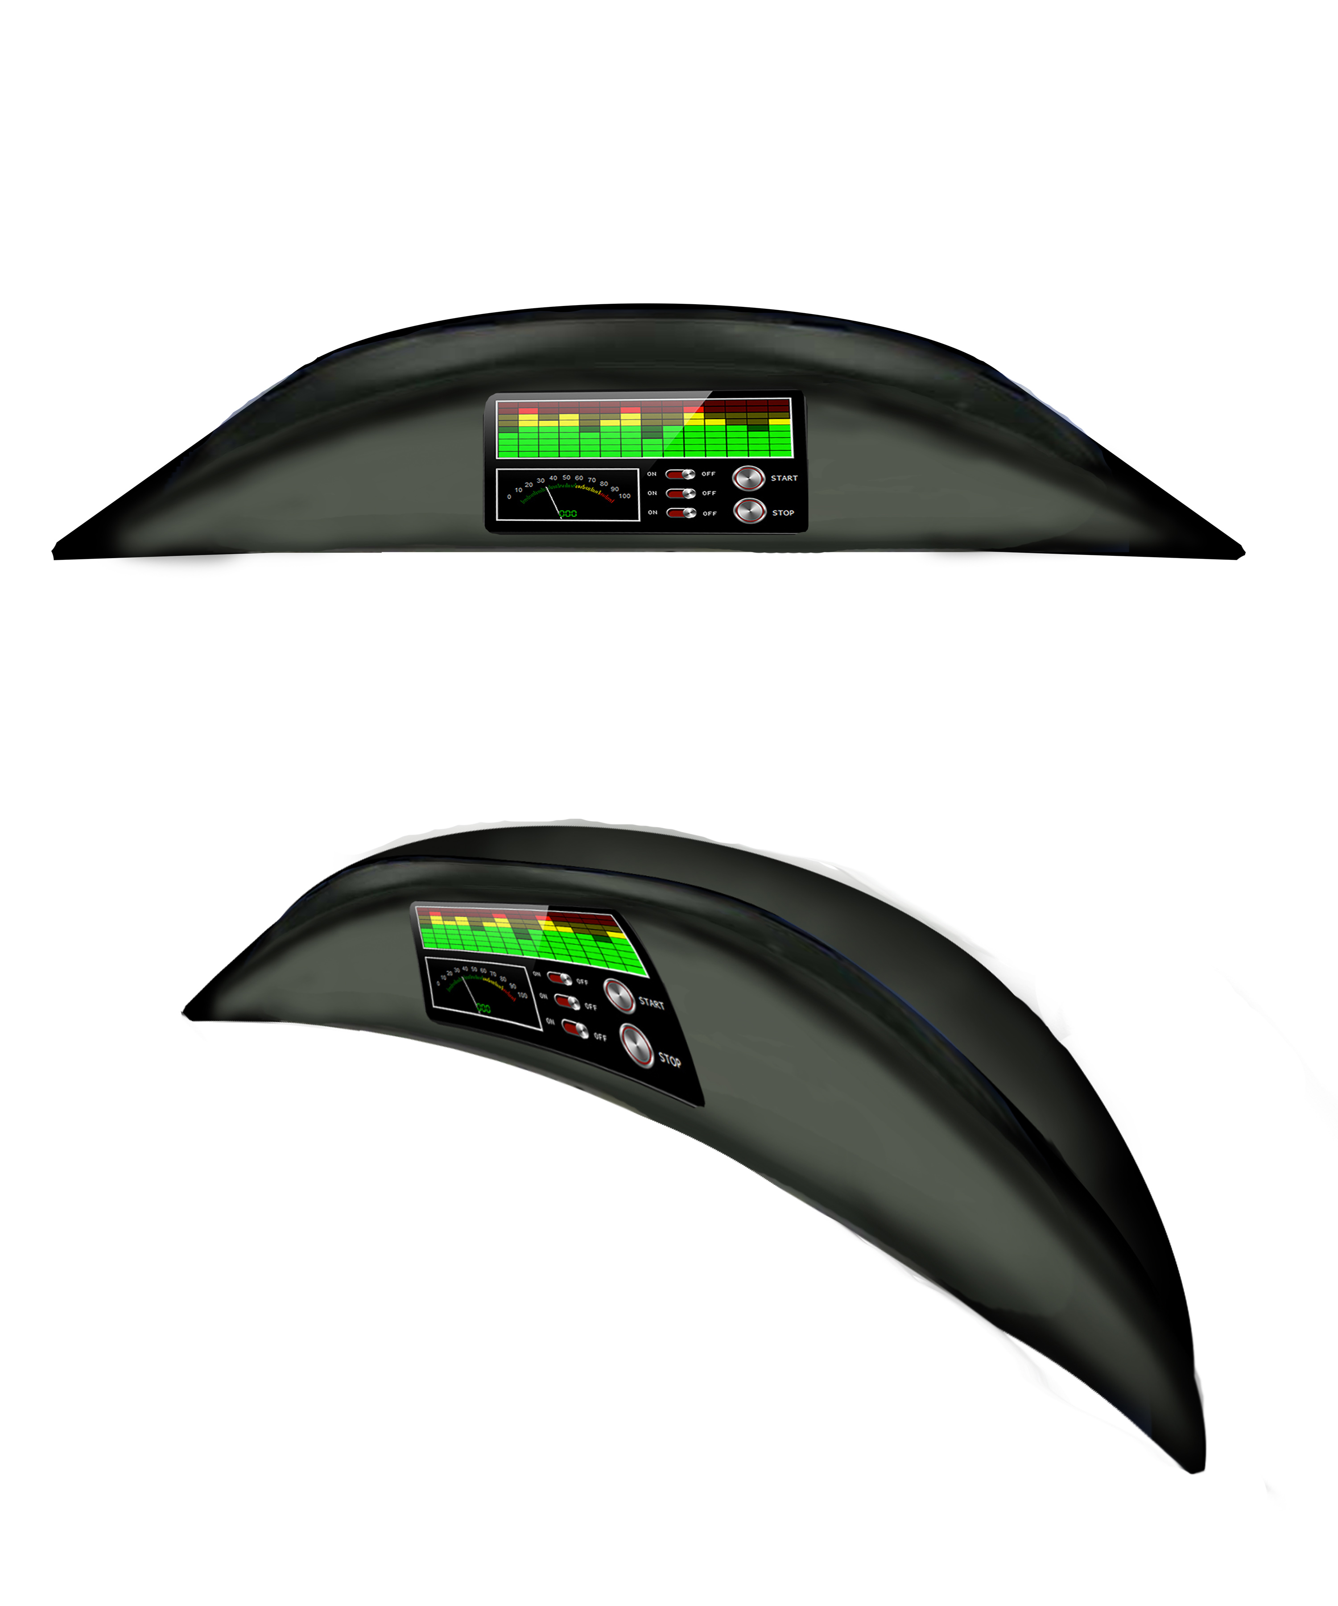
Device Chosen
CAN Protocol for data antiquation with serial to LCD
AT90CAN Atmel
AMS-42700 On Semiconductor
uLCD-35DT 4D systems

Slide 4

Microcontroller
AT90CAN32
  8bit,32K flash
  16MHz
  CAN, EBI/EMI, I²C, SPI, UART/USART
Pros
  Cheap, $8
  Easy to use, and develop
  CAN Controller
Cons

Slide 5

CAN Transceiver
AMIS-42700
  Specially designed to provide a link between a CAN controller (protocol IC) and two physical CAN busses.
Pros
  Ideally suited for 12 V and 24 V industrial and automotive applications
  High speed (up to 1 Mbit/s in function of the bus topology)
  Fully compatible with the ISO 11898−2 standard
Cons
  Additional components

Slide 6
Reasons for Choices
CAN is the standard for vehicle communication
Low message transfer latency
Simplicity to implement and expand
Other options
  Serial
  Wireless
  USB

Slide 7

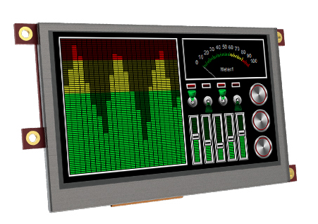
LCD Screen
P/N uLCD-35DT
2.7” LCD display
3.5” LCD display
4.7” LCD display (too large)
Pros
  Resistive Touch
  Color display
  Power Graphics processor
  Simple tools to create Gui
  High Resolution
Cons
  Screen is not polarized, difficult to see in sunlight (shield can be bought)

Slide 8
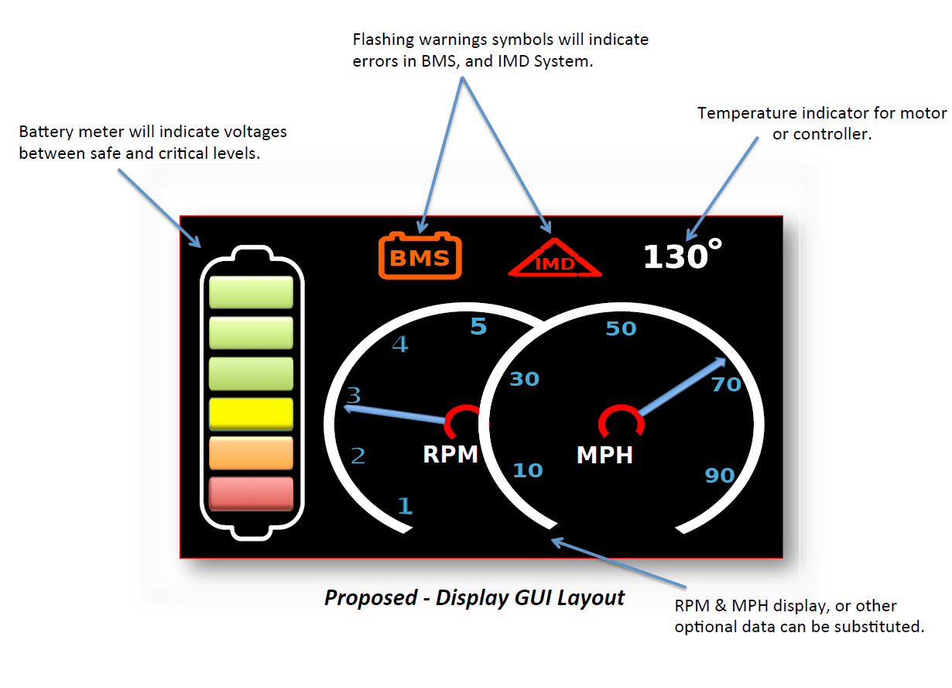
GUI Layout

Slide 9
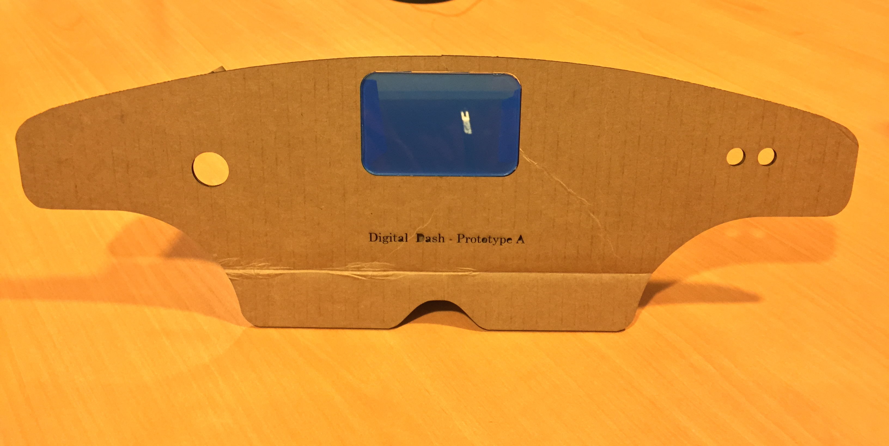
Enclosure
On top of dash
Pros
  Looks good
Cons
  3D Printed (expensive)
  Sticks out of cockpit (rule violation?)
In Dash
Pros
  Looks good
  Waterproof
Cons
  3D Printed (expensive)
  Limited View

Slide 10
Budget
AT90CAN ~$10, plus ~$20 for board FAB
4D 3.5" Screen ~$150 for screen & shield
Deutsch Connectors ~$10
Enclosure ~$50
$250 for one system

Slide 11
Project Timeline
Software Design: Early February
Ordering Parts: Immediately
Hardware Design: Early-Mid February
Testing: Mid-Late February
Final Design Implementation: Late February and early March
Documentations: Throughout

Slide 12
Project Timeline
Software Design: Early February
Ordering Parts: Immediately
Hardware Design: Early-Mid February
Testing: Mid-Late February
Final Design Implementation: Late February and early March
Documentations: Throughout

Slide 13
Questions & Concerns?

